Slide 1
DEEP LEARNING TENSORFLOW
Applied Regression and Neural network to predict the healthcare cost
By: Phong Nguyen

Slide 2
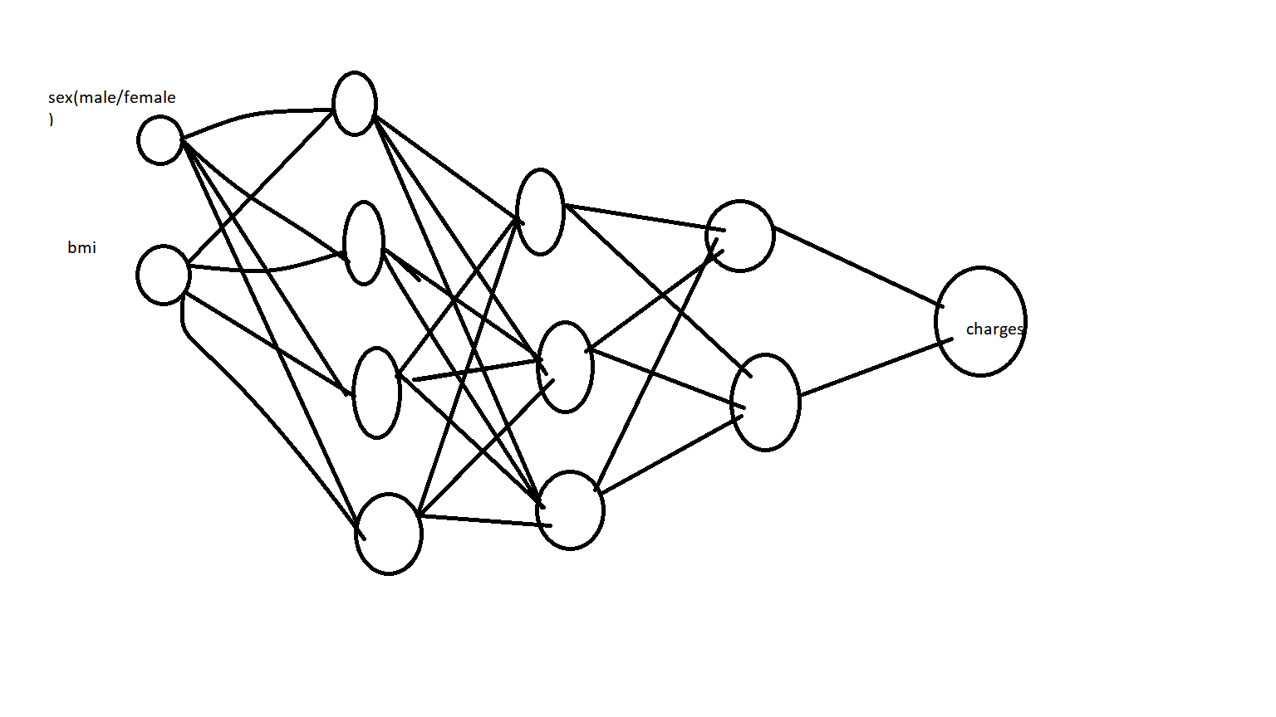
Projects Overview
Deep Learning is very difficult subject. In this project
Deep Learning is applied to predict the healthcare insurance price. The technique in Deep Learning is applied TensorFlow.
The Methods are Applied Regression and Neural Network. The raw data is downloaded from Kaggle.com [3].

Slide 3
Explore data
Explore the raw data
> MFdata=caret::createDataPartition(y=mydata$sex, p=400/600,list=FALSE)
> trainset=mydata[MFdata,]
> testset=mydata[-MFdata,]
> head(trainset)
age sex bmi children smoker region charges
1 19 female 27.90 0 yes southwest 16884.924
3 28 male 33.00 3 no southeast 4449.462
5 32 male 28.88 0 no northwest 3866.855
6 31 female 25.74 0 no southeast 3756.622
7 46 female 33.44 1 no southeast 8240.590
10 60 female 25.84 0 no northwest 28923.137

Slide 4
Explore the data
Create two separated datasets.
Male dataset
Female dataset
summary(Mdata) age bmi children smoker region charges Min. :18.00 Min. :15.96 Min. :0.000 no :517 northeast:163 Min. : 1122 1st Qu.:26.00 1st Qu.:26.41 1st Qu.:0.000 yes:159 northwest:161 1st Qu.: 4619 Median :39.00 Median :30.69 Median :1.000 southeast:189 Median : 9370 Mean :38.92 Mean :30.94 Mean :1.115 southwest:163 Mean :13957 3rd Qu.:51.00 3rd Qu.:34.99 3rd Qu.:2.000 3rd Qu.:18990 Max. :64.00 Max. :53.13 Max. :5.000 Max. :62593

Slide 5
Create LMS Models
LMS Male model:
MaleModel=gamlss(data=Mtraindata,
+ charges~1,
+ sigma.formula = charges~1,
+ nu.formula = charges~1,
+ family=BCCG(mu.link="log"),
+ trace=FALSE,
+ parallel="multicore",
+ ncpus = numCores)
> MaleModel1=stepGAICAll.A(MaleModel, scope=list(lower=~1,
+ upper=~poly(age,2)+poly(bmi,3)+pb(age)),
+ sigma.scope = list(lower=~1,
+ upper=~poly(age,2)+poly(bmi,3)+pb(age)),
+ k=log(length(trainM)),
+ trace=FALSE,
+ parallel="multicore",
+ ncpus = numCores)

Slide 6
Create LMS Model
Female model
FemaleModel=gamlss(data=Mtraindata,
+ charges~1,
+ sigma.formula = charges~1,
+ nu.formula = charges~1,
+ family=BCCG(mu.link="log"),
+ trace=FALSE,
+ parallel="multicore",
+ ncpus = numCores)
>
> FemaleModel1=stepGAICAll.A(FemaleModel, scope=list(lower=~1,upper=~poly(age,2)+poly(bmi,3)+pb(age)),sigma.scope = list(lower=~1,upper=~poly(age,2)+poly(bmi,3)+pb(age)),k=log(length(Ftraindata)),trace=FALSE,parallel="multicore",ncpus = numCores)

Slide 7
Create Deep Learning Models
Male Model
build_model <- function() {
+ model <- keras_model_sequential() %>%
+ layer_dense(units = 128, activation = "relu",
+ input_shape = dim(male_train_data)[[2]]) %>%
+ layer_dense(units = 128, activation = "relu") %>%
+ layer_dense(units = 128, activation = "relu") %>%
+ layer_dense(units =128, kernel_regularizer = regularizer_l2(0.001))%>%
+ layer_dense(units = 1)
+

Slide 8
Create Deep Learning Model
Female model
female_test_targets<-Ftestdata%>%
+ dplyr::select(charges)%>%
+ as.matrix()%>%
+ as.array.default(dimnames=NULL)
> build_model_female <- function() {
+ model_female <- keras_model_sequential() %>%
+ layer_dense(units = 128, activation = "relu",
+ input_shape = dim(female_train_data)[[2]]) %>%
+ layer_dense(units = 128, activation = "relu") %>%
+ layer_dense(units = 128, activation = "relu") %>%
+ layer_dense(units =128, kernel_regularizer = regularizer_l2(0.001))%>%
+ layer_dense(units = 1)
+

Slide 9
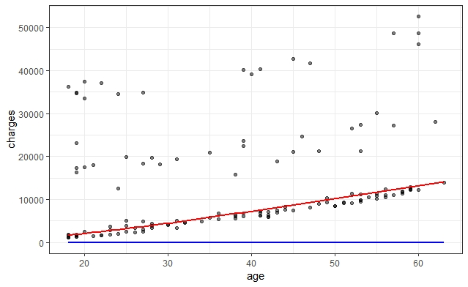
Results – Compare both methods

Slide 10
Conclusions and Chalenging:
Older age will pay more healthcare cost
Deep Learning is difficult technique
Deep Learning provided more accuracy results in predicting the data
Another hardware challenging, a powerful machine would be helpful. Bigger dataset will take more time for computer to execute the model. Thus a powerful machine with powerful graphic card is very important.

